Slide 1
Data Analysis and Syndromic Surveillance using R
Lecture 1
Nicholas Link

Slide 2
Acknowledgements
Materials
Isabel Fulcher
Bethany Hedt-Gauthier
Michael Law
Collaborators
Anuraag Gopaluni
Bethany Hedt-Gauthier
Emma Boley
Luke Krangar
Patrick Konwloh
Prince Varney

Slide 3
Expectations
Questions
Raise hand.
Ask at any time!
Breaks
Structured breaks ~1/hour
Take whatever breaks you need
What to have out
Lectures: Paper and pen
Labs: Computer

Slide 4
Daily Structure (roughly)
Today:
11am-12pm: Lecture
12-1pm: Lunch
1-3pm: Lab
3-4pm: Lecture
Tuesday – Friday:
9am – 1015am: Lecture
1030am – 12pm: Lab/Project
12-1pm: Lunch
1pm – 2pm: Lecture
215pm – 4pm: Lab/Project
4pm – 5pm: (Optional) Office hours/extra help
* Friday end at 1pm

Slide 5
In this lecture
My background
Goals of this training
Motivating example – syndromic surveillance
Intro to R

Slide 6
Background and Overview

Slide 7
My background
BA in applied math
Taught high school math for 2 years.
Completing PhD in Biostatistics at Harvard
Coding in R!
(outside of work): Enjoy cooking, making music, and spending time with my two cats and fiancé.

Slide 8
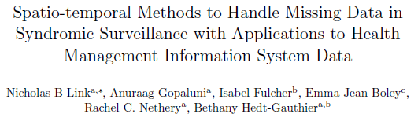
Syndromic Surveillance Work
Ran a simulation study on syndromic surveillance on HMIS data using spatio-temporal models and with missing data.
Collaborating with HIS team about syndromic surveillance and this training.

Slide 9
Breakout Question
Why are you attending this training?
What are you hoping to learn?
What background skills and knowledge do you bring?
Share your answers with someone next to you

Slide 10
My Response
Why am I conducting this training?
Share my experience with coding and statistics.
To support the work of the Liberia MOH team.
What am I hoping to learn?
To learn form the public health expertise in this group.
Gain experience leading trainings.
What do I bring?
Enthusiasm and training in statistics and R.

Slide 11
Goals of this training
Become familiar with the R programming language.
Understand syndromic surveillance and implement an outbreak detection model.
Understand linear regression.
To describe and interpret the models used.
Implement data cleaning, modeling and visualization process in R.

Slide 12
Survey review (n = 7)
1 person has used R. Everyone has used Excel
Half of the people that responded have programming experience.
Most people have not heard of linear regression.
Everyone does data analysis in their work.
What types of data analysis?
People are interested in learning programming!
Importantly, the foods I need to try….
Rice and beans, fufu and soup, greens and rice, red oil greens, fried potato greens, jollof rice, smoked fish dried rice

Slide 13
Motivating Example – Syndromic Surveillance

Slide 14
Core common questions
What diseases or outcomes (e.g. vaccinations) are you interested in monitoring and addressing in Liberia?
What questions are important to answer about these diseases?
e.g. how can we detect COVID-19 outbreaks when there is limited testing?

Slide 15
Core common questions
How can we learn from the COVID-19 pandemic to address emerging diseases?
What is the burden of Lassa Fever and mPox?
How can we conduct surveillance on diseases that are hard to track?

Slide 16
How can we leverage routinely collected data to improve COVID-19 response?
Syndromic Surveillance
Health Service Utilization
What regional areas have a higher than expected increase in the number of patients with COVID-19-associated symptoms?
How do the number of individuals receiving care during the COVID-19 pandemic compare to what is expected?
The methods for routine monitoring will involve identifying “deviations” from what is expected for further investigation.
Notes:
There are TWO goals of this activity.
The first goal is to assessing the direct impact of COVID19 through syndromic surveillance. This involves using data on symptoms or outcome directly related to COVID-19 to flag geographic areas for potential COVID-19 circulation. This does not use information on positive COVID-19 tests, but instead uses information on symptoms, such as pneumonia or flu-like symptoms, to identify hotspots.
The second goal is to quantify the indirect impacts of COVID19 on utilization of essential health services, which range from assessing changes in the number of outpatient visits to the number babies delivered in a health facility to the number of children receiving their immunizations.
Despite being two distinct goals, these goals do share the fact they BOTH use routinely collected data and look for deviations from what is “expected”. And so, the data science tools that we use will be similar.

Slide 17
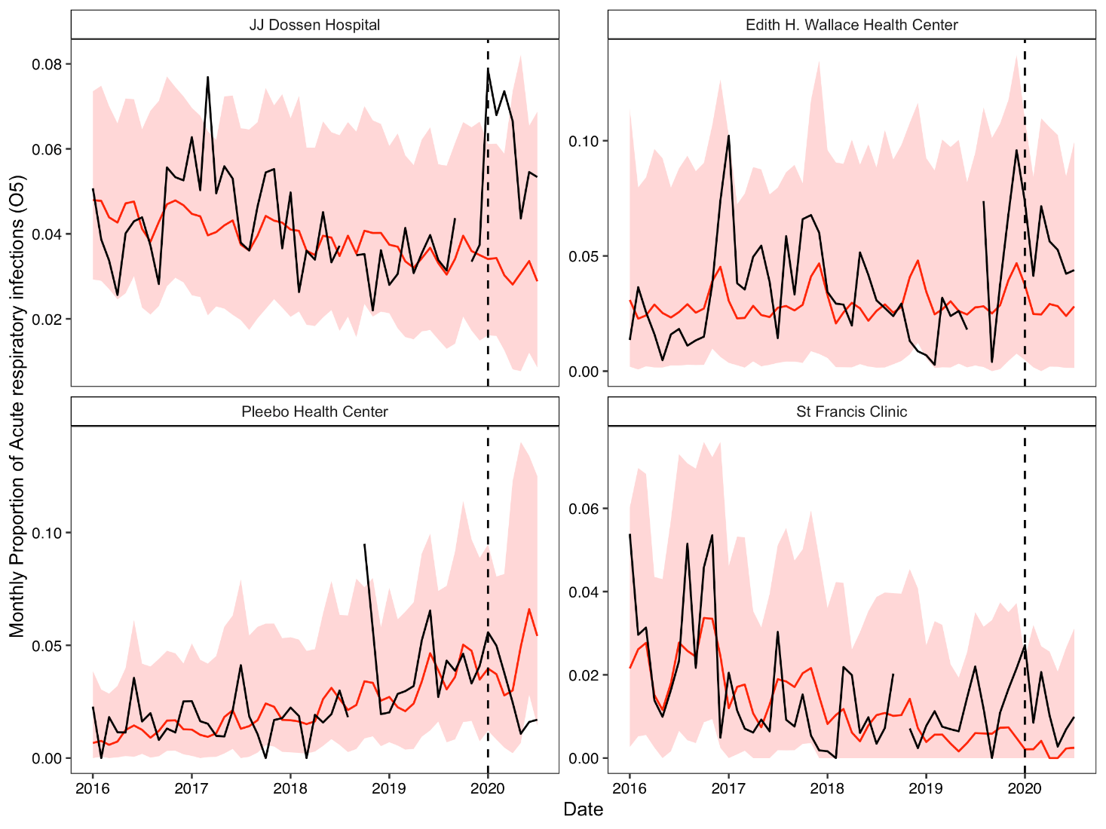
Increased in ARI cases at 3 PIH-supported facilities in Maryland County for ages ≥5 years
Higher proportions of ARI cases were also observed at JJD, Edith Wallace and St. Francis late 2019 into early 2020 at these 3 PIH-supported facilities in Maryland County for individuals 5 years or older.
Red: predicted visits based on prior data with 95% prediction intervals
Black: observed visits
Dotted line: Extrapolation period begins
Credit: Emma Boley, Izzie Fulcher

Slide 18
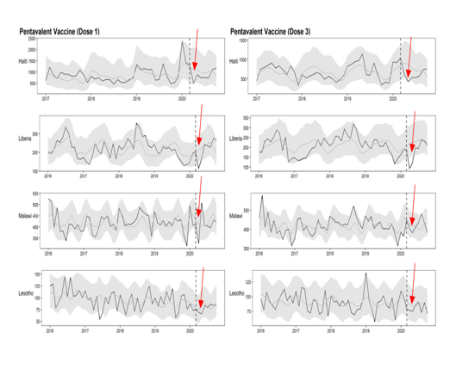
Steeper reductions observed in Pentavalent in Haiti, Liberia & Malawi early in 2020
We observed reduce pentavalent vaccination coverage for both doses (1 & 3), but reduction was not sustained!
Credit: Emilia Connolly, Emma Boley, Izzie Fulcher

Slide 19
Selecting indicators

Slide 20
What is an indicator?
An indicator is a quantitative metric that can be used to:
Monitor uptake
Assess achievement
Provide warnings
Indicators should be well-defined and consistently measured.
What sources of data are there for indicators in Liberia?

Slide 21
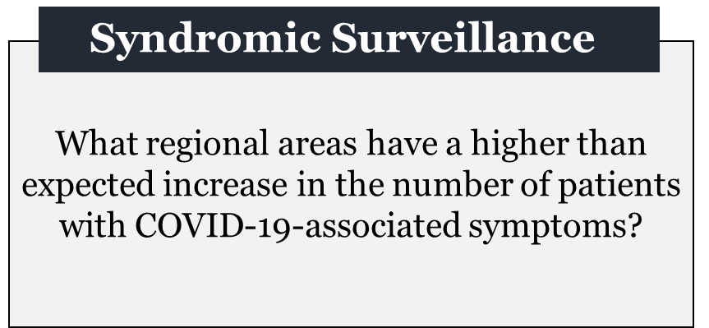
Syndromic surveillance
Monitor disease symptoms rather than the disease itself.
Not as good as monitoring the disease itself.
May give indicators of where disease is present, if it is difficult to monitor directly.

Slide 22
COVID-19 Surveillance
Ideally, we would monitor COVID-19 directly.
What indicators are groups using to look directly at COVID-19?
Why is it not always possible to use these indicators to monitor COVID-19?

Slide 23
mPox and Lassa Fever Surveillance
In small groups, answer:
What indicators could we use for mPox?
For lassa fever?
What issues might arise from either of these indicators?
What are ideal properties for indicators to be used for syndromic surveillance?

Slide 24
Recommended indicators

Slide 26
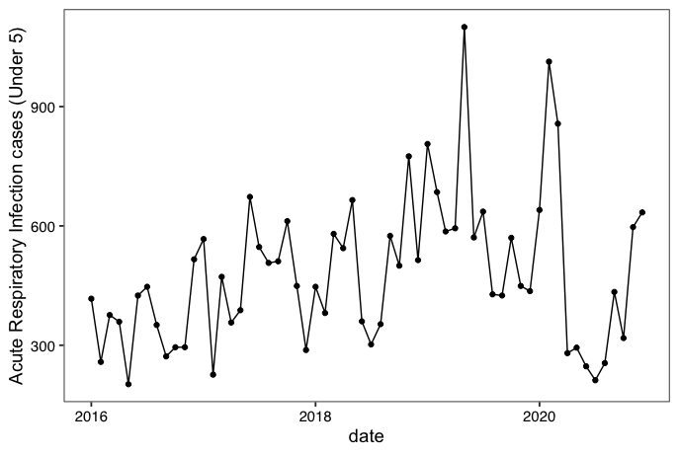
Acute Respiratory Infection cases among children (under 5) for Neno District Hospital (Malawi)

Slide 27
Health service utilization indicators
Assess uptake of essential health services.
Compare uptake to “expected”.
Assessment of reasons for changes.
Targeted interventions to address any deficits.

Slide 29
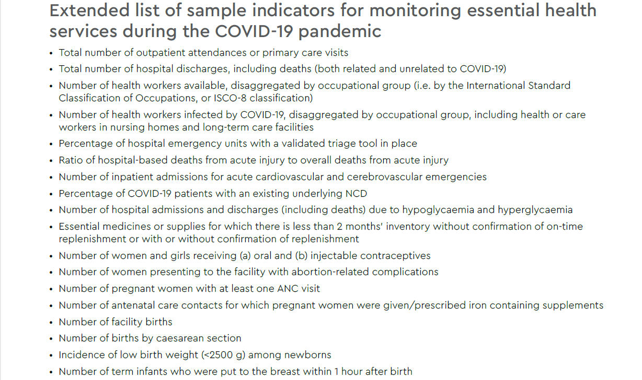
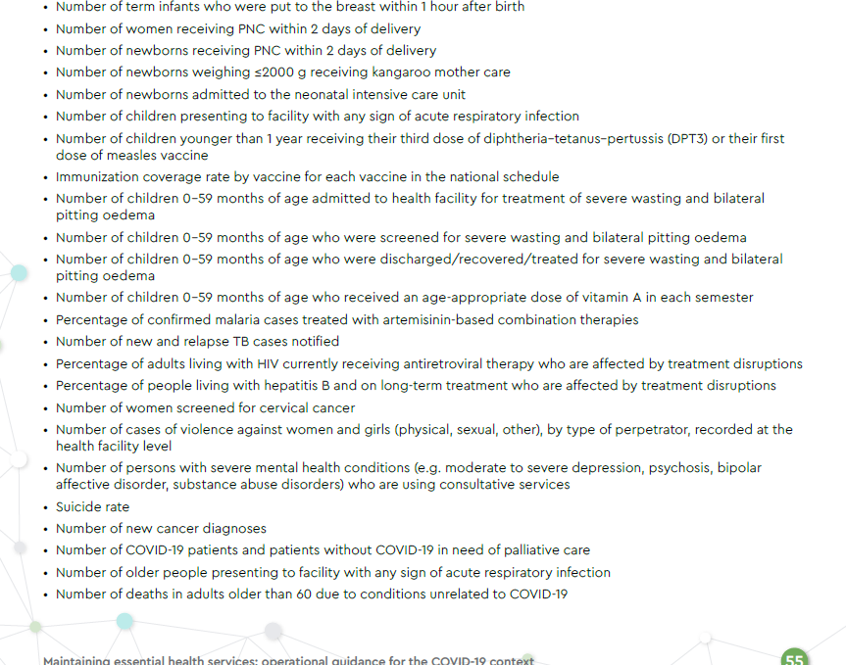

Slide 30
What about service utilization indicators?
Which of the ideal properties remain true when looking at HSU indicators?
Are there any different considerations when selecting HSU indicators?

Slide 31
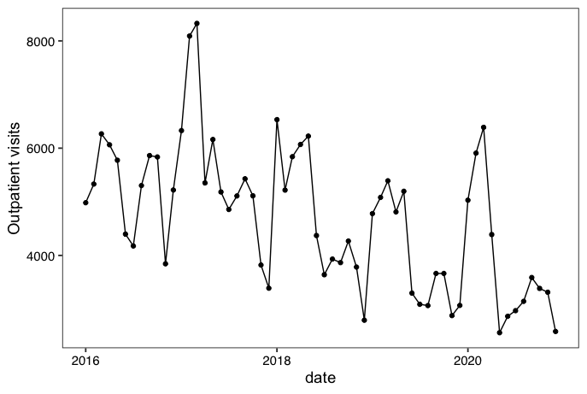
Outpatient visits for Lisungwi Health Centre

Slide 32
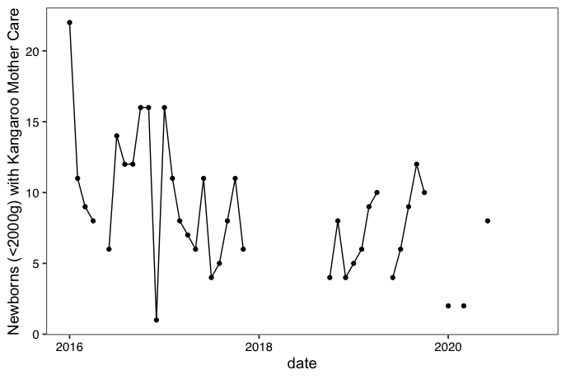
Kangaroo Mother Care indicator for Neno District Hospital

Slide 33
What’s next?
Day 2: Linear regression and building basic time series models
Day 3: Determining expected and comparing to observed
Day 4: Data processing and visualization
Day 5: Syndromic Surveillance research + projects

Slide 34
Lab

Slide 35
Why use R?
It is free!
It has extensive packages for (almost) any specialized tool/analysis.
Easy data manipulation and graphics
Easy reproducibility (R Markdown)
Computationally faster than Stata

Slide 36
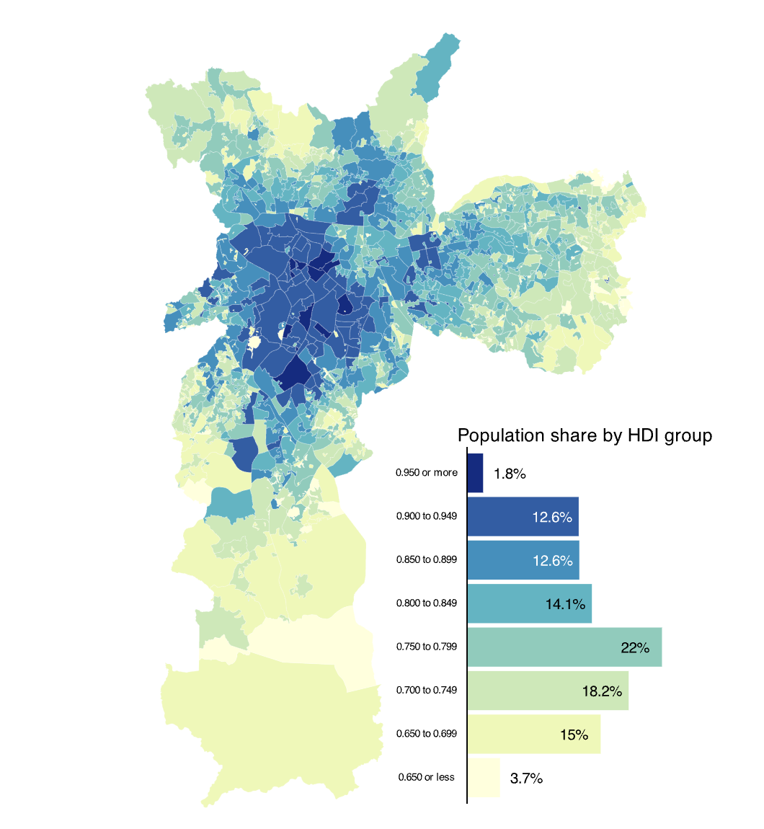
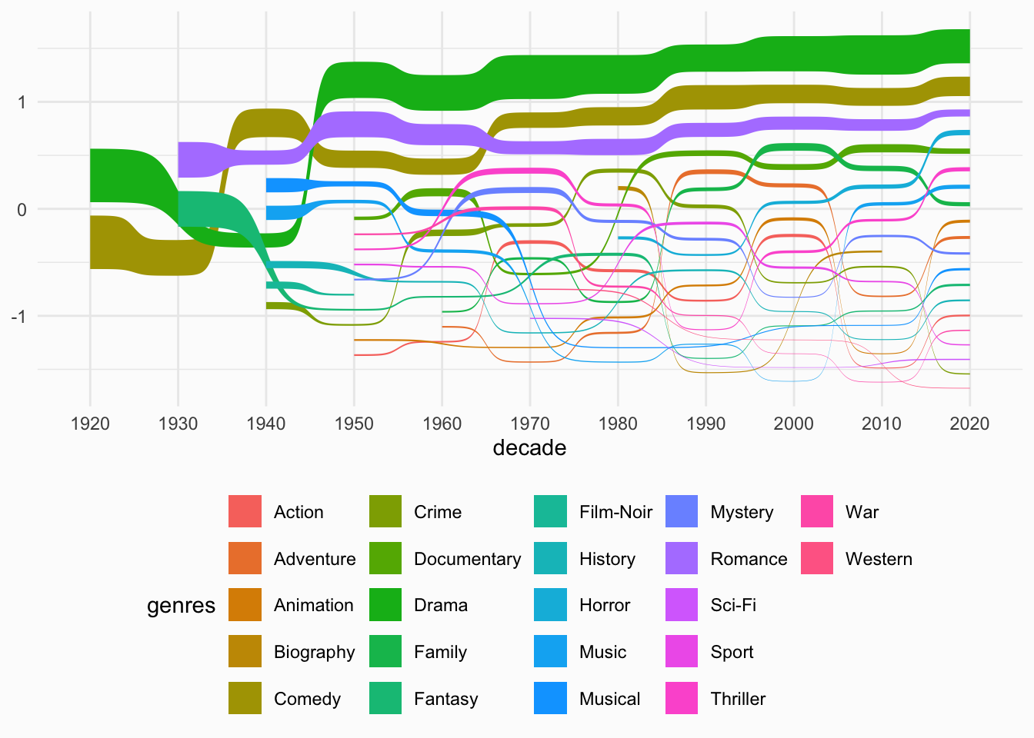
R examples
https://r-graph-gallery.com/
https://hoga.shinyapps.io/healthdown/

Slide 37
Logistics
Course materials: https://tinyurl.com/yyufvh6t
Bookmark this page – we will be using it a lot!
Install R and Rstudio

